Slide 1
Image Maps

Slide 2

Image Maps
An image that contains hyperlinked, clickable regions, sometimes called "hot spots"
Each hot spot is defined by a set of coordinates (indicating its position on the image) and a URL reference
Two types of image maps:
  Client-side (the most common)
  Server-side (rarely used)

Slide 3

Image Maps
If you could see an image with its map, it might look like this:
These areas might link to EAR.HTM
Each area could be a separate link.
This area might link to FEET.HTM

Slide 4
Image Maps
Each area is defined by coordinates in pixels.
For rectangular areas, it is the upper left and lower right.
This area might be defined as 2,200 (upper left) 205,300 (lower right)

Slide 5
Defining Hot Spots
Three shapes for hot spots:
  Rectangle
  Circle
  Polygon

Slide 6
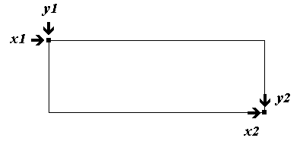
Rectangle Hot Spot
Any two points can define a rectangle
Each point is represented by a horizontal (x) coordinate and a vertical (y) coordinate
Rectangles are defined by four coordinates representing the upper-left and bottom-right corners of the rectangle
  Code:
  <area shape="rect" coords="1,52,33,96" href="hand.htm" />

Slide 7
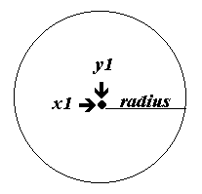
Circle Hot Spot
Circles are defined by two coordinates and a radius
  Code:
  <area shape="circle" coords="x1,y1,radius" href="url"/>
The pair of coordinates specifies
the circle's center
A third number specifies
the desired radius,
or half-width, of
the circle

Slide 8
Polygon
x1,y1
x2,y2
<AREA SHAPE=“poly”
COORDS=“x1,y1,x2,y2,x3,y3,x4,y4,…”
HREF=“url”>
Replace x1,y1 with two numbers: horizontal and vertical position of a point on the edge of the polygon
Add more x,y pairs until you have traced around the desired shape
x6,y6
x3,y3
x5,y5
x4,y4

Slide 9
Four Steps to Create a Client-Side Image Map
Select image to use
Define areas of image map
  Three shapes: circle, rectangle, polygon
  X and Y coordinates in pixels
  Get coordinates from a graphics program such as Paint Shop Pro or Photoshop

Slide 10
Four Steps to Create a Client-Side Image Map
Include map information in HTML document:
  <MAP></MAP> - NAME attribute names the map
  <AREA> tags identify shapes in map
    SHAPE attribute – circle, rect, poly
    HREF attribute – URL to load
    COORDS – x and y coordinates of shape
Connect image with map information
  USEMAP attribute in <IMG> tag
  USEMAP value is map name with a # symbol before it

Slide 11
Creating Client-Side Image Maps
Can use target=window_name for frames
    <map name="books">
    <area shape="poly" coords="70,0, 0,37, 0,183, 27,192, 27,48, 103, 9" href="file.html“ alt=“Books”>
    </map>
    <img src="image.gif" usemap="#books">
Image Maps

Slide 12
Image Maps
The HTML code to make an image map begins with the IMG tag.
Here is a sample:
<IMG SRC=“pig.gif” USEMAP=“#MIG”>
USEMAP says that the graphic is an image map.
MIG is the name of the map definition (# means “look in this same document”).

Slide 13
Image Maps
The image map definition begins with a map tag:
<MAP NAME=“MIG”>
The name of this map definition is MIG.
</MAP> ends the definition.
The lines in between describe the areas (by coordinates) and the web pages that they link to.

Slide 14
Image Maps
The lines between <MAP NAME=“MIG”> and </MAP> define the areas, one tag for each area.
Here is an example from the pig:
<AREA SHAPE=RECT HREF=“FEET.HTM” COORDS=“2,200 205,300”>
The shape of the area is a rectangle, the link goes to FEET.HTM, the upper left of the rectangle is at 2,200 and the lower right of the rectangle is at 205,300.

Slide 15

Image Maps

Slide 16
<img src="tmahal.jpeg" usemap = #imgmap border=0>
<map name=imgmap>
<area shape=Rect Coords=30,30,59,59 Href="taj.jpg" Target="_blank">
<area shape=Rect Coords=100,60,129,80 Href="elephant.gif" Target="_blank" >
</map>
Image Maps

Slide 17
Image Maps
How can I find the coordinates?
You can search shareware sites for image map programs.
You can use a graphics program, if it shows the position of the cursor with “pixels”.
Move the cursor over the picture and write down the appropriate coordinates.

Slide 18
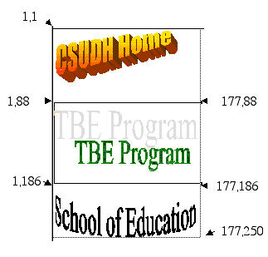
Image Maps
Here is a simpler graphic with coordinates:

Slide 19
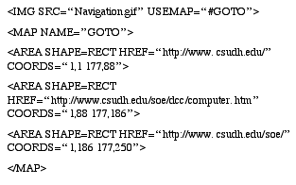
Image Maps
The accompanying HTML code for the image map:

